Slide 1
Balance Sheet Inputs Master
Overview & Details
29th November, 2016

Slide 2
Overview
The Balance Sheet Inputs Master gives the user flexibility to add/delete/edit parameters on the Balance Sheet Inputs form.
The user can create sections, sub-sections or parameters to capture relevant data through the Balance Sheet Inputs form.
User also has the flexibility to move the Sections / Sub-Sections/ Parameters up or down as required and create the layout for the Balance Sheet Inputs form.
The layout created has two sections - Profit & Loss and Balance Sheet (two Sub-Sections – Liabilities & Assets).
Data Output – Saving the changes made using Edit button or adding new parameters are directly reflected in the Balance Sheet Inputs Form. If the position of parameters is changed using the Up/Down arrows, Save Changes must be clicked so that the changes reflect in the Balance Sheet Inputs Form.

Slide 3
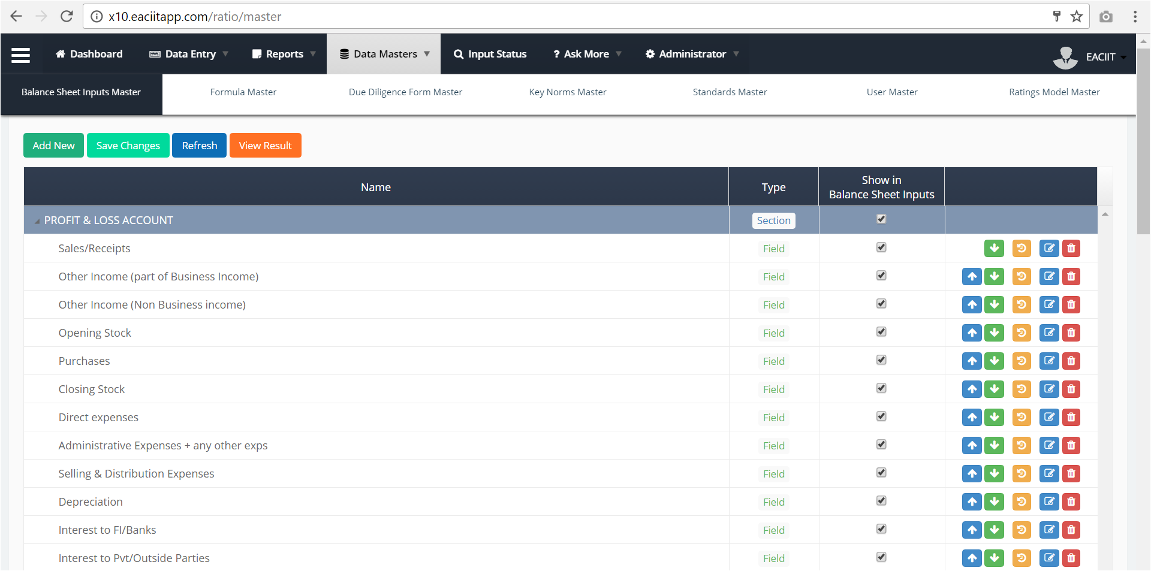
Add new section/sub-section/parameter
Opens the Balance Sheet Inputs form where User can view the changes made
Controls visibility of a Section / Sub-section / Parameter on the Balance Sheet Inputs Form
Up / Down buttons to change the positioning of the parameters in the layout. Edit button (blue) to update the parameter.
History button : Functionality needs confirmation from client.
User can delete a parameter using the delete button –
A parameter can be deleted only when it is not Saved on the Balance Sheet Inputs form.
User cannot delete a Section / Sub-Section directly. Only when all parameters for a Sub-Section and all Sub-Sections and parameters have been deleted for a Section, the Sub-Section and Sections will be deleted automatically.

Slide 4
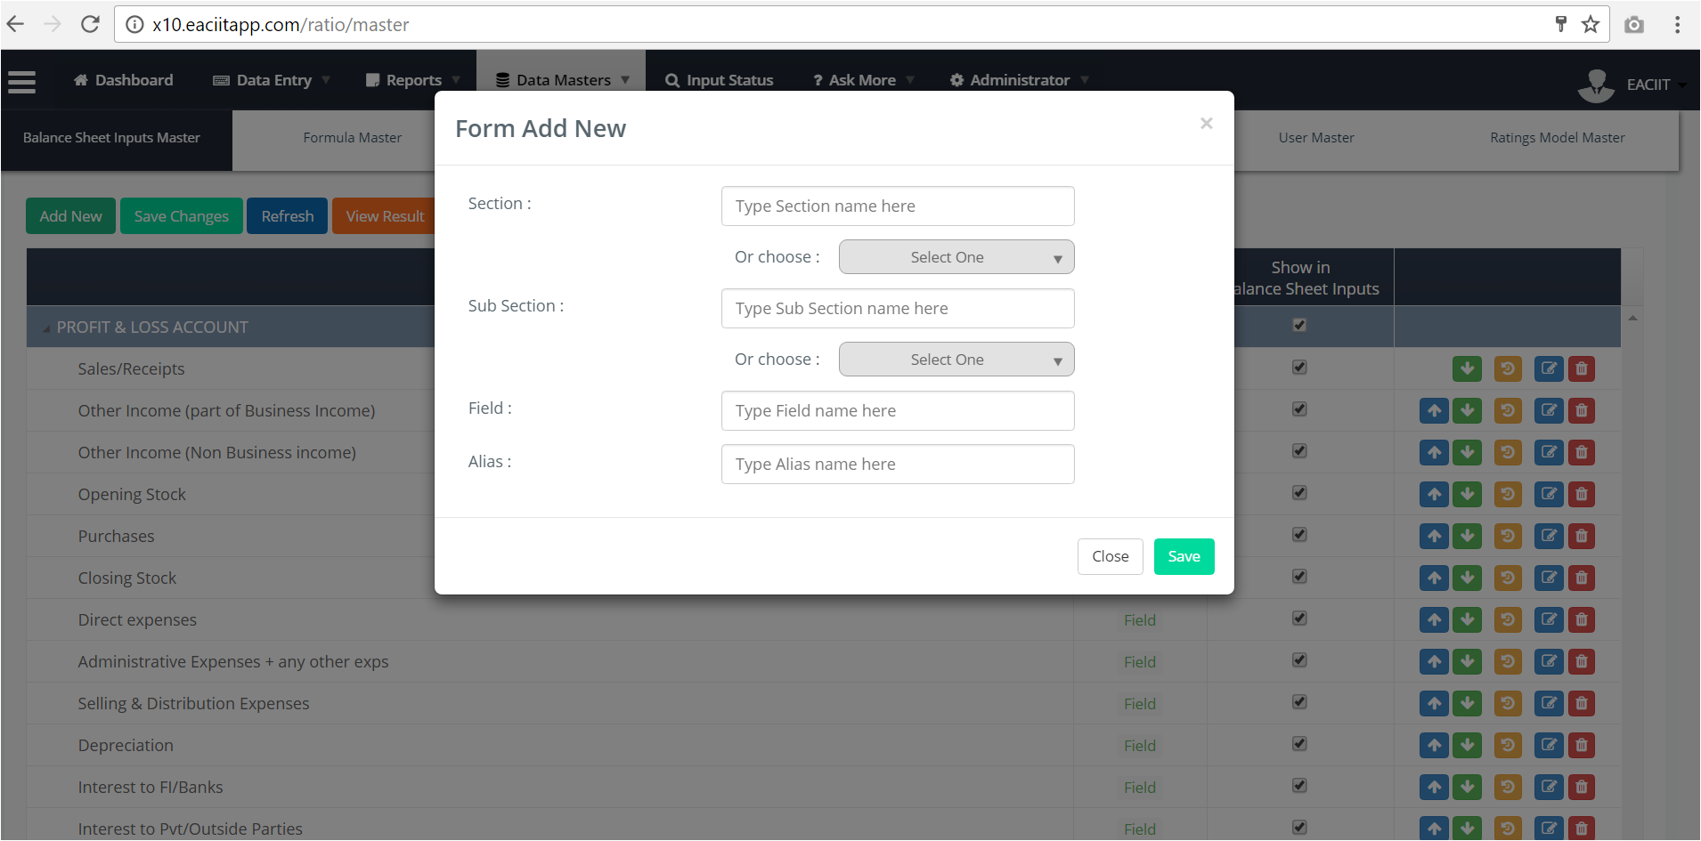
User can –
Select from a list of Section Names.
Type a Section name, in case he wants to create a new Section.
This is a mandatory field.
Add New Functionality
User can –
Select from a list of Sub-Sections for the selected Section.
Type a Sub-Section name, in case he wants to create a new Section.
This is not a mandatory field. If no Sub-Section is selected the new Parameter will be created under the selected Section.
User can enter name of the parameter here.
This is a mandatory field.
User must enter an alias for the new parameter.
This is a mandatory field.

Slide 5
<End of Balance Sheet Inputs Master Specs>

